Slide 1
Synthesis of 4,4’-di-tert-butylbiphenyl
Friedel-Crafts Alkylation
Chemistry 318
Fall 2018

Slide 2
Schedule of day
PPE check – at the door
Pre-lab check – at the door
Quiz
Recitation
Nitration, part II
Synthesis of 4,4’-di-tert-butylbiphenyl
Safety
Put bags away
Goggles
Gloves
Lab Coat
LAB!

Slide 3
Due Dates
Today
At beginning of lab – Separation Scheme for Nitration of Methyl Benzoate
Spectroscopy Problem Set (Part II, #2)
at end of lab -- copy of laboratory notebook pages for today's experiment (continuation of Nitration and new Friedel-Crafts)
Next Week
At beginning of lab - Nitration of Methyl Benzoate Report
Spectroscopy Problem Set (Part II, #3)
Two Weeks
Synthesis of 4,4’-di-t-Butylbiphenyl Report
Spectroscopy Problem Set (Part II, #4,5)

Slide 4
Grading from last week
Review the errors you made on the Bromination Report.
Most likely, you will need to review significant digits; reaction mechanisms (not chemical equations)
Notice that the graded parts correspond to the explicit instructions on BlackBoard and the Manual for writing this report.
If you have questions about how it was graded, please ask.
Quiz- if there is a Video assigned for an experiment, there will be quiz questions asked from it.
Notebook – be sure to include all categories required for the pre-lab (such as equipment/chemicals/glassware).

Slide 5
Synthesis Lab Reports
Follow the instructions posted on Blackboard under “Notebook & Report Formats”.
Synthesis labs require a Separation Scheme, which is a flowchart describing how the product was purified from the reaction mixture.
See the example in Blackboard & the Lab Manual, 14-16.
Separation schemes represent the ideal situation and include all steps in the experimental procedure (whether completed in lab or not) and all possible impurities.

Slide 6
Synthesis Lab Reports
Pay attention to significant digits (0.002 has only one significant digit).
Note the example in the Lab Manual for calculating moles of strong acids such as H₂SO₄ and HNO₃.
Note the example for completing the table on the report form that is the calculation of the theoretical yield.
Pay special attention to citing physical property data (M.W., density, etc.) as explained in the Citation section of the Lab Manual.

Slide 7
In Lab Today
Finish the Nitration experiment
Weigh the final product: weigh empty vial, place product in vial, weigh again. Use a rolled paper funnel to transfer the solid to the vial.
Take melting point of product.
Increase temperature slowly
Range: from first drop of liquid to complete melting
Take an IR using a thin film (either acetone or dichloromethane).
Properly label the vial containing the product.
Submit the vial before the end of the period.
Perform Friedel-Crafts Alkylation Expt.

Slide 8
Friedel-Crafts Alkylation
Today is our last example of S_{E}Ar!
When an alkyl group, R, is substituted on the aromatic ring in the presence of a Lewis acid, the reaction is termed a Friedel-Crafts Alkylation.
The experiment today involves the aromatic biphenyl (both rings are alkylated) and tert-butyl chloride.
The catalyst (a mixture of aluminum chlorides) is formed in situ by the reaction between Al and t-BuCl.

Slide 9
Friedel-Crafts Alkylation
The electrophile (t-butyl carbocation) is generated from t-BuCl and the AlR₂Cl catalyst.
The t-butyl carbocation reacts with the π electrons in the aromatic ring to form the arenium ion.
The electrophile enters the para position because the resulting resonance stabilization also includes the π electrons of the other benzene ring (ortho attack is sterically hindered)

Slide 10
Friedel-Crafts Alkylation
The arenium ion loses a proton (H⁺) to regenerate the ring aromaticity.
The reaction by-product is HCl (gas).
The AlR₂Cl catalyst is regenerated.
A second reaction then takes place on the other aromatic ring to give the final product.

Slide 11
Safety
Safety
Dichloromethane (solvent) is a known carcinogen upon chronic exposure. Use caution and work in the hood when specified.
Before beginning reflux: Check all seals and clamps on glassware. Make sure the top of the condenser is not sealed. Ensure the water flow goes IN at the bottom and OUT at the top.
Have the instructor CHECK your apparatus before turning on the heat.

Slide 12
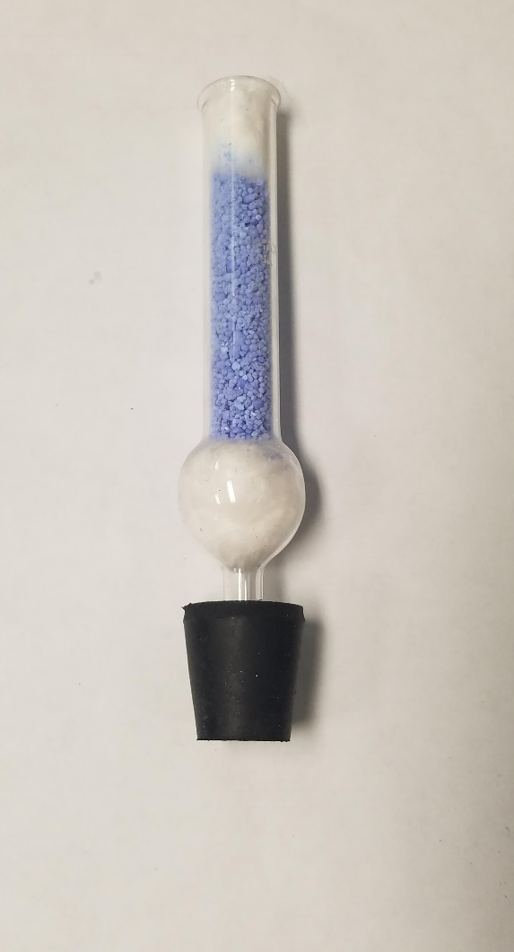
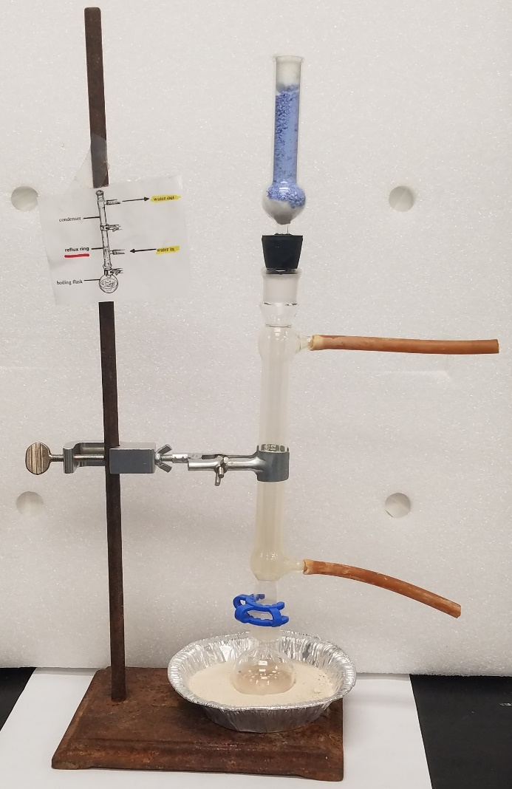
Experimental Notes
Replace the funnel/beaker gas trap shown in the experiment with a drying tube filled with Neutrasorb (which will react with and absorb the evolved HCl gas). Blue Neutrasorb becomes white when it reacts with acid.
The instructor must approve your reflux set-up before you begin heating your flask.
Neutrasorb goes blue -> white when it reacts with HCl

Slide 13
Experimental Notes
Use a long-stem glass funnel to deliver all liquids to the round-bottom reaction flask and sep funnel.
Use a rolled paper funnel to transfer biphenyl to reaction flask.
BEFORE lab: make sure you can calculate the mass of biphenyl needed for the reaction to maintain the stoichiometric ratio.
BEFORE lab: make sure you know which layer in separatory funnel (aqueous or organic) contains your product and know which layer is top/bottom (check densities).
Notes:
The pellets have been treated with acid to remove the layer of aluminum oxides and hydroxides, exposing a surface of Al⁰. Increase the surface area of the pellet by sanding its surface.

Slide 14
Experimental Notes
Add sanded aluminum pellet to reaction mixture through the top of reflux apparatus.
Hot plate should be set no higher than 2.
Record all color changes and time in your notebook.
Wait for the reaction mixture to come to room temp. before transferring to sep. funnel.
Review extraction with separatory funnel and drying agents in Morig assignment.

Slide 15
Experimental Notes
NEVER throw anything out until you are sure you have your product isolated!
Keep the organic extract in an Erlenmeyer flask (never a beaker).
Always keep a beaker under the funnel in case of leaks.

